Slide 1
Interpretability
SVR
MLP
LMT

Slide 2
Strategy
SOC depends on kernel, number of features and number of support vectors. (Appendix I).
We will try various kernel functions.
Reduce number of features using SelectKBest with f_regression.
We can adjust number of support vectors using NuSVR (Appendix II) and
by tuning hyper-parameters.

Slide 3
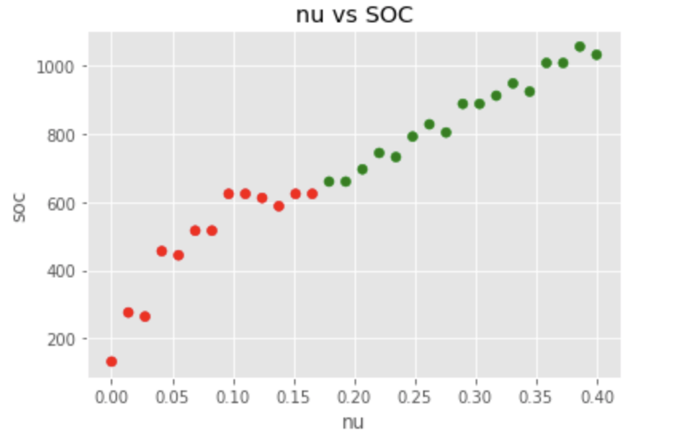
Servo
Only rbf kernel is considered, other kernels exceed the limit (Appendix III)
Final result Intermediate results
 | Error optimized | SOC optimized
Configuration | SVR(C=46.416,gamma= 0.215, kernel='rbf’) | NuSVR(nu=0.1932,C=1000, gamma=0.464, kernel='rbf’)
Number of features | 4 | 3
MAE | 0.227 | 0.241
SOC | 1185 | 660
SV | 79 | 55
Format: MAE & SOC | Bu tuning hyper-parameters of standard SVR | Nu SVR
k=4 | 0.2267 & 1185 | 0.245 & 1035
k=3 | 0.2399 & 1236 | 0.241 & 660
k=2 | 0.414 & 873 | 0.414 & 963

Slide 4
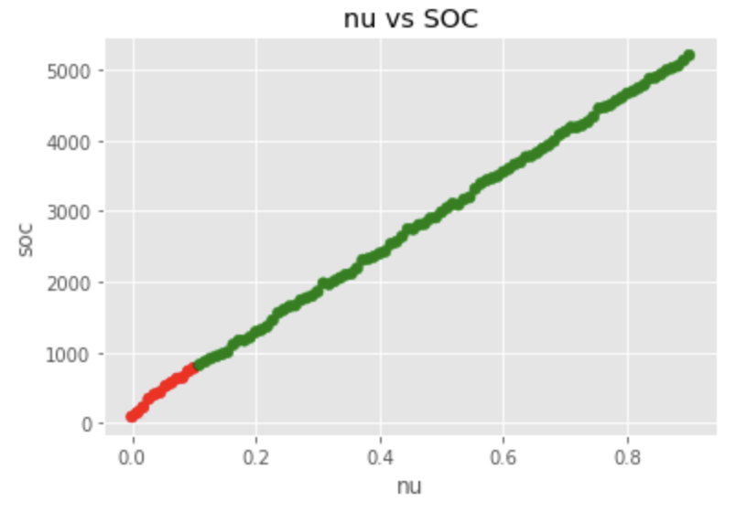
Auto MPG
Only rbf kernel is considered, other kernels exceed the limit (Appendix III)
Final result Intermediate results
Metric\ Dataset | Error optimized | SOC optimized
Configuration | SVR(C=12.742749857031335, gamma= 0.11288378916846883,'kernel='rbf’) | NuSVR(nu=0.07461,C=233.57,gamma=0.4833,'kernel='rbf’)
# of features | 5 | 4
MAE | 1.830 | 2.007 (10%)
SOC | 6264 | 795 (%)
SV | 348 | 53 (-1.44 %)
Format: MAE & SOC | Bu tuning hyper-parameters of standard SVR | Nu SVR
k=5 | 1.8316 & 6264 | 2.006 & 1062
k=4 | 1.8465 & 5340 | 2.007 & 795
k=3 | 2.686 & 4212 | 2.695 & 2316 (more number of support vectors was selected)

Slide 5
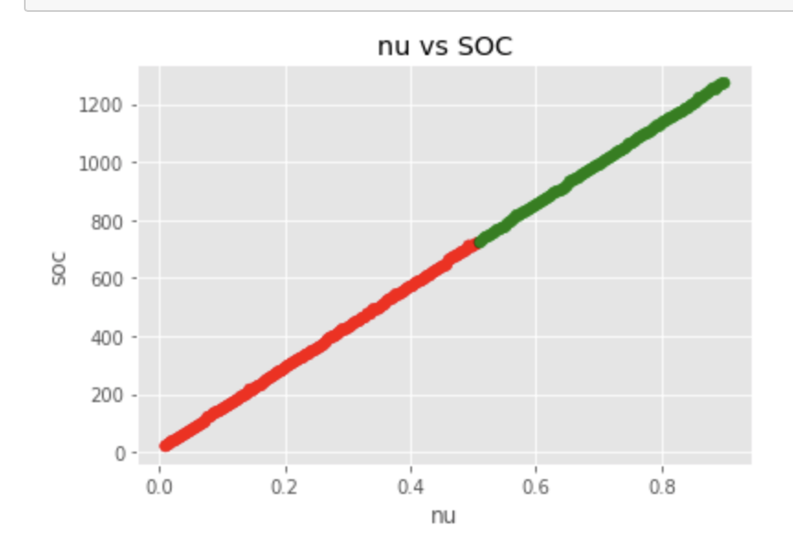
Forest Fire
Format: MAE & SOC | Bu tuning hyper-parameters of standard SVR | Nu SVR Same mae?
k=12 | Will be updated
k=11
k=10
k=9
k=8
k=7
k=6
k=5
k=4
k=3
k=2
k=1
Linear kernel is considered, since it produces lower SOC(Appendix III)
Metric\ Dataset | Error optimized | SOC optimized
Configuration | SVR(C=16.68100537200059,gamma=0.1, 'kernel': 'rbf') | NuSVR(nu=0.51 ,C=0.0001,kernel=’linear’)
# of features | 12 | 1
MAE | 5.147 | 5.653 (+9.8%)
SOC | 17550 | 723 (%)
SV | 450 out of 468 | 241

Slide 6
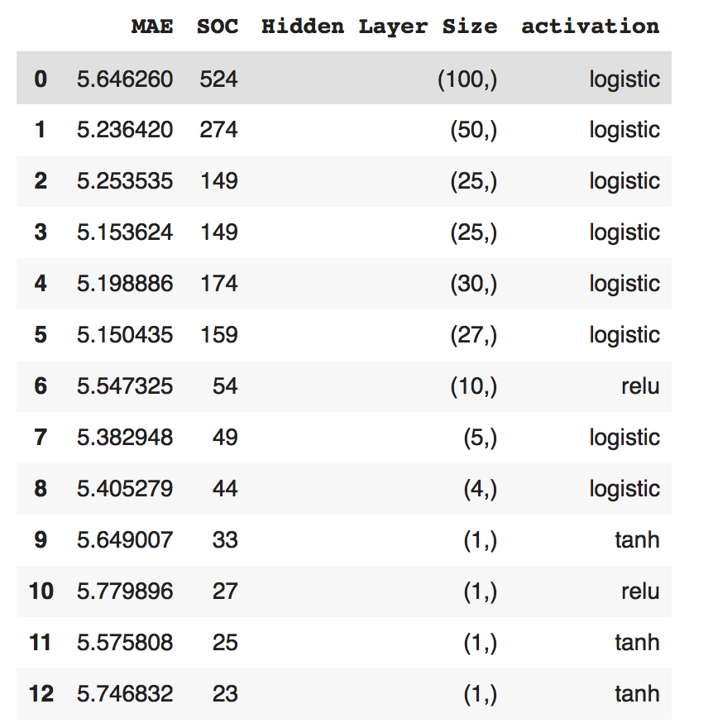
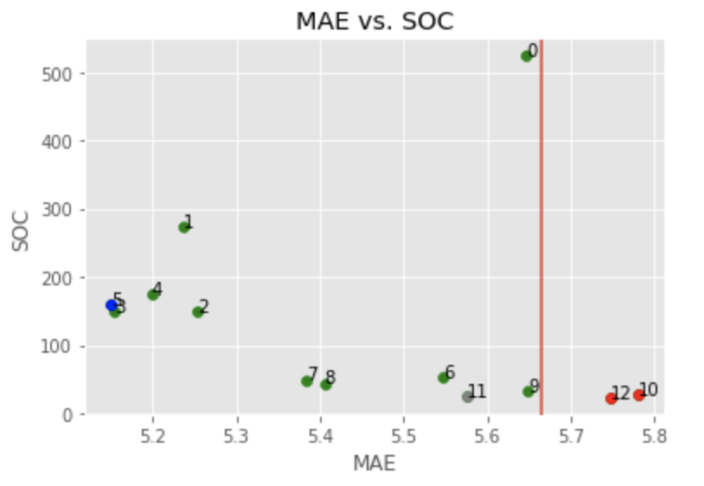
MLP.Forest Fire
Allowed parameters
Not allowed parameters for mse/mae
Best parameter in terms of mse/mae
Best parameters in terms of both mse/mae & soc
Metric\ Dataset | Error optimized | SOC optimized
MAE & SOC | 5.150 & 159 | 5.576 & 25 +8.27% & -84.27%
Parameter for MAE | logistic, ( 27, ) | tanh, ( 1, )
# of features | 12 | 8

Slide 7
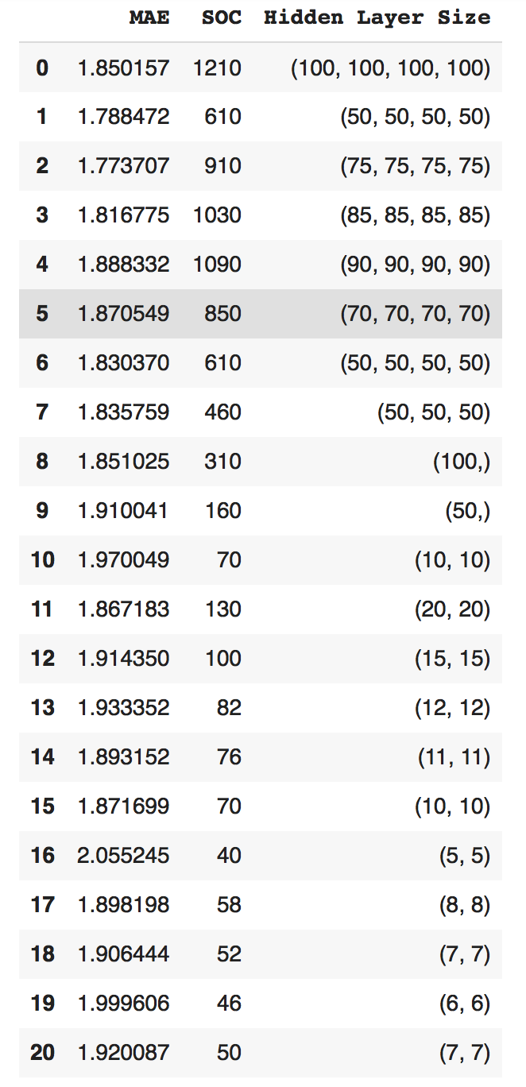
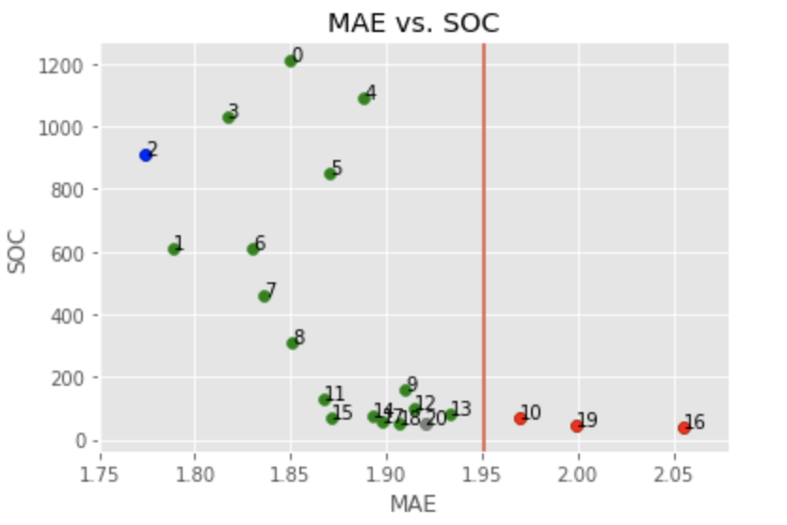
MLP.AutoMPG
Allowed parameters
Not allowed parameters for mse/mae
Best parameter in terms of mse/mae
Best parameters in terms of both mse/mae & soc
Metric\ Dataset | Error optimized | SOC optimized
MAE & SOC | 1.773 & 910 | 1.920 & 50 +8.29% & -97.80%
Parameter for MAE | relu, ( 75, 75, 75, 75 ) | relu, ( 7, 7 )
# of features | 5 | 4

Slide 8
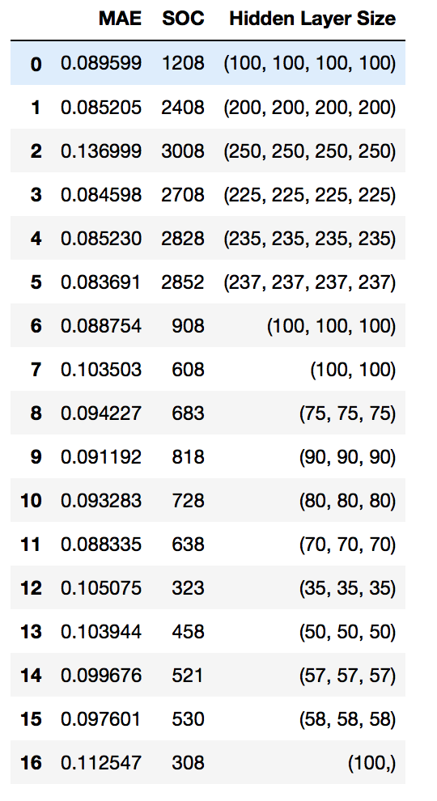
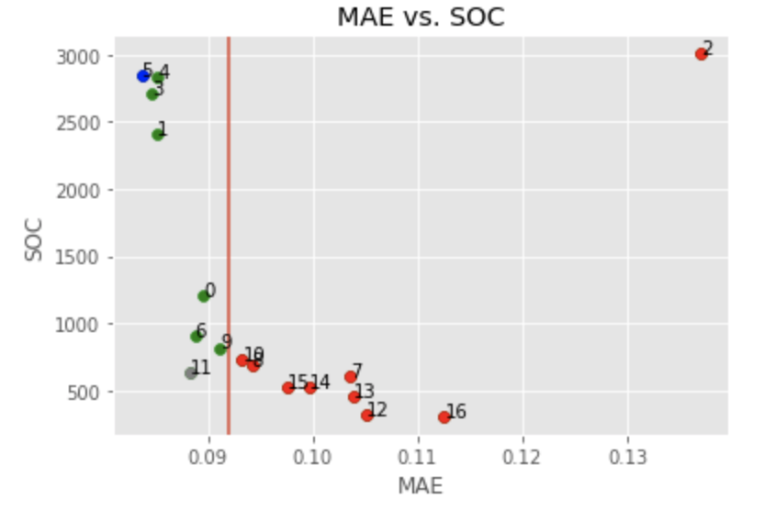
MLP.Servo
Allowed parameters
Not allowed parameters for mse/mae
Best parameter in terms of mse/mae
Best parameters in terms of both mse/mae & soc
Metric\ Dataset | Error optimized | SOC optimized
MAE & SOC | 0.083 & 2852 | 0.088 & 638 +6.02% & -77.62%
Parameter for MAE | relu, ( 237,237,237,237 ) | relu, ( 70, 70,70 )
# of features | 4 | 4

Slide 9
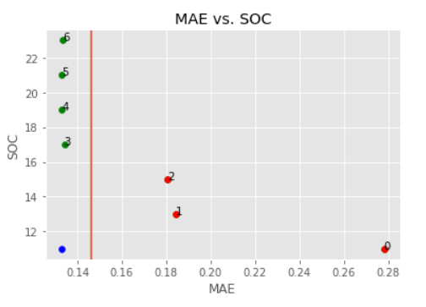
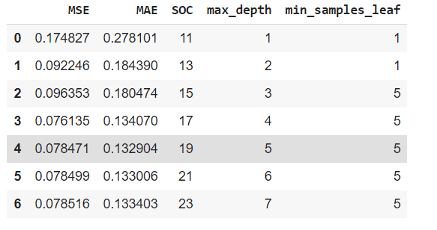
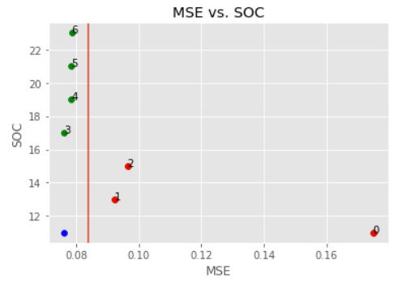
LMT. Servo
Metric\ Dataset | Error in terms of accuracy (best MAE) | SOC optimized
Configuration | ‘max_depth’:5, 'min_samples_leaf': 5 | ‘max_depth’:4, 'min_samples_leaf': 5
MSE & MAE | 0.078 & 0.132 | 0.076(-2.56%) & 0.134(+1,51%)
SOC | 19 | 17 (-10.52 %)

Slide 10
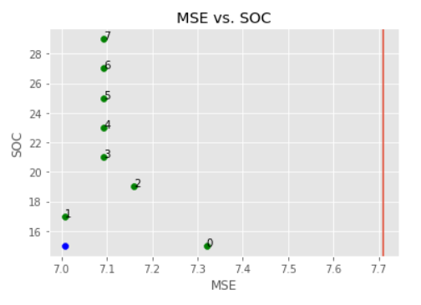
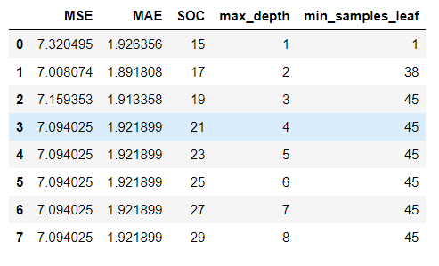
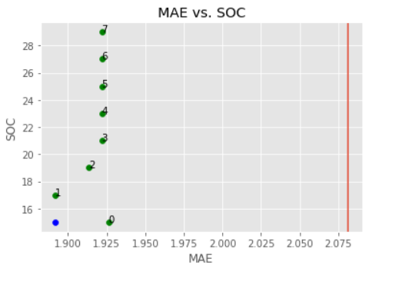
LMT. Auto-MPG
Metric\ Dataset | SOC | SOC optimized
Configuration | ‘max_depth’:2, 'min_samples_leaf': 38 | ‘max_depth’:1, 'min_samples_leaf': 1
MSE & MAE | 7.008 & 1.891 | 7.32 (+4.45%) & 1.926 (+1,85)
SOC | 17 | 15 (-11.76 %)

Slide 11
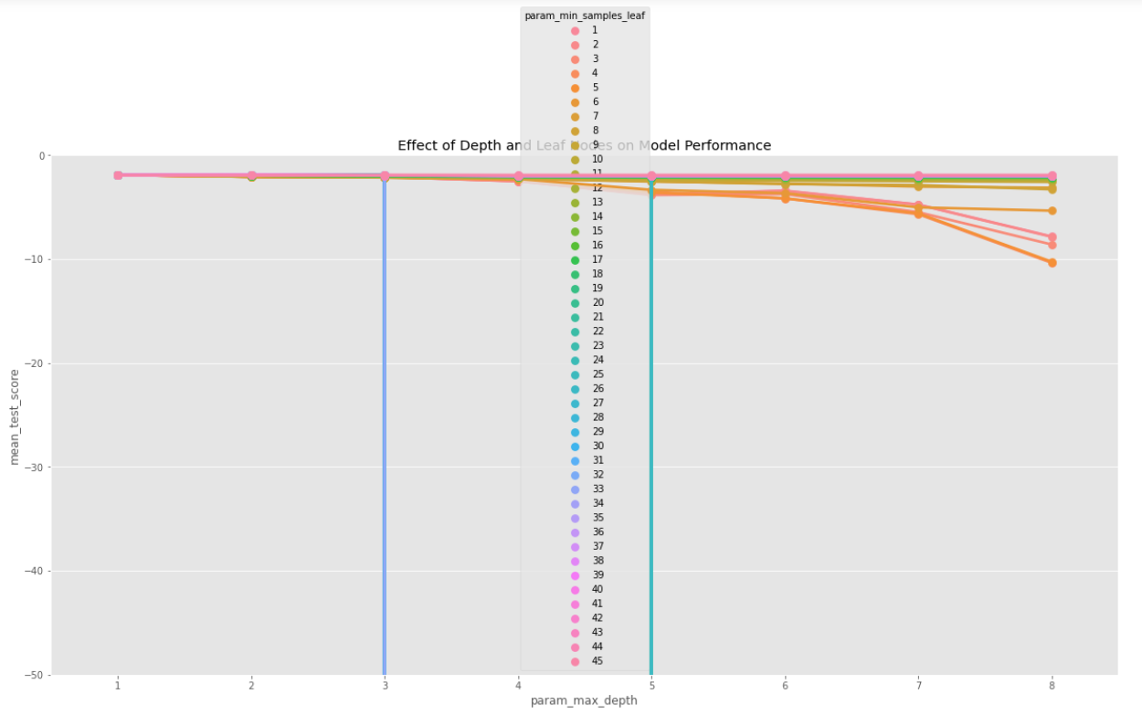
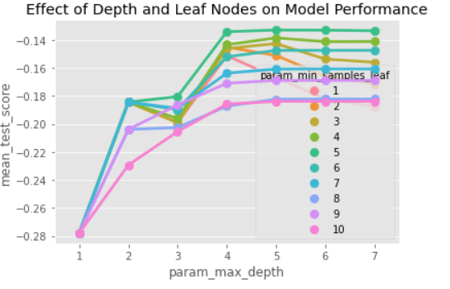
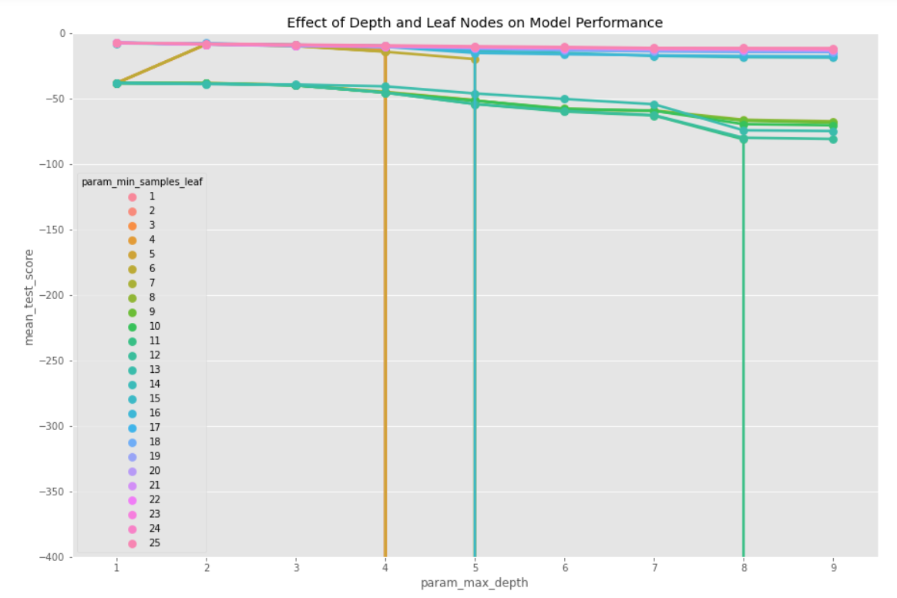
Model Selection LMT
Auto-MPG Servo Forest Fire

Slide 12
Model Comparison
MAE
Dataset \ Model | SVR | MLP | MLT
Servo | 0.227 | 0.088 | 0.132
AutoMPG | 1.830 | 1.92 | 1.891
Forest Fire | 5.147 | 5.576 | 7.180
SOC
Dataset \ Model | SVR | MLP | MLT
Servo | 660 | 638 | 19
AutoMPG | 795 | 50 | 17
Forest Fire | 723 | 25 | 27

Slide 13
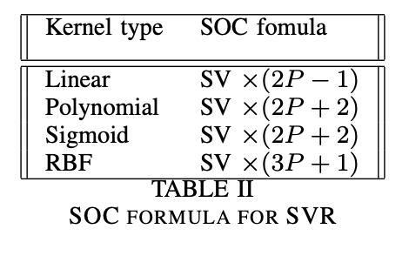
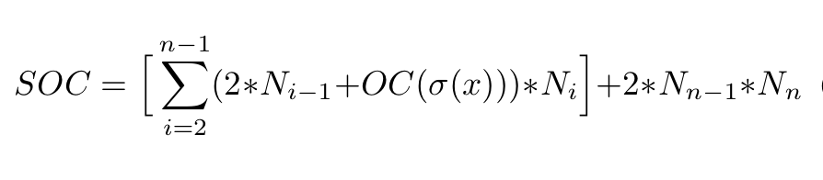
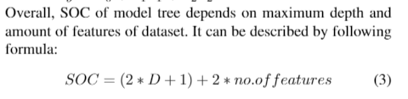
Appendix I
SOC formula for MLP

Slide 14
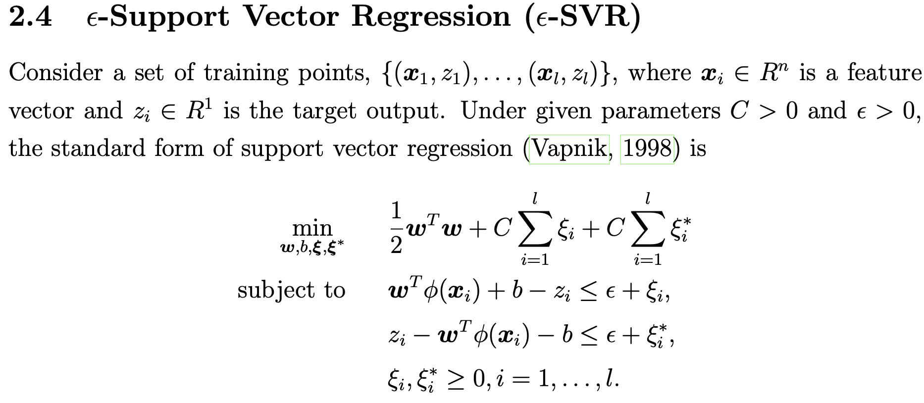
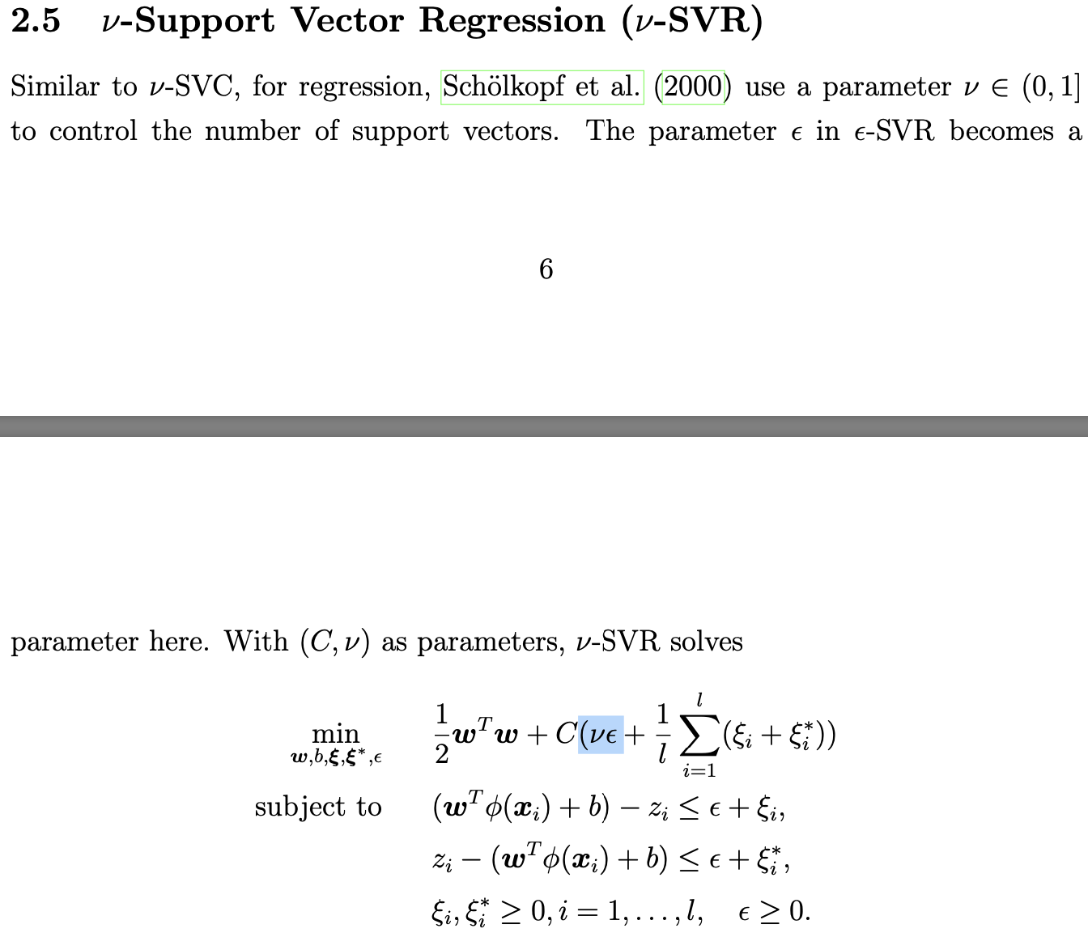
Appendix II
NuSVR
SVR
Ref: libsvm

Slide 15
Appendix III
Servo
MAE \ Kernel | linear | polynomial | sigmoid | rbf
MAE | 0.6768 | 0.7323 | 0.6737 | 0.2267
Auto MPG
MAE \ Kernel | linear | polynomial | sigmoid | rbf
MAE | 2.331 | 2.627 | 2.334 | 1.830
Forest Fire
MAE \ Kernel | linear | polynomial | sigmoid | rbf
MAE | 5.222 | 5.3474 | 5.3474 | 5.147

